Slide 1
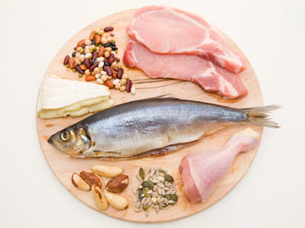
Element Poster Title
This is an example poster.
It shows you how your protein poster could look.
You don’t have to make it look just like this.
I hope that you find this helpful.
It is just a way to get you started.

