Slide 1
Turning in Assignments to Mr. B on Edmodo

Slide 2
1. Create a new Google Doc

Slide 3
2. Title the Google Doc, “Practice turning things in to Mr. B”

Slide 4
3. Type “This is a test!” in the body of your document.

Slide 5
4. Click the blue “Share” button in the top right corner of the page.

Slide 6
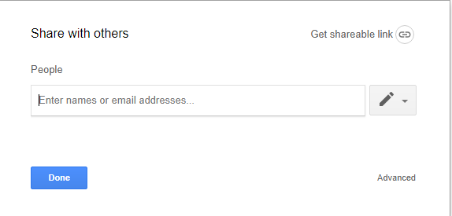
5. Choose “Get shareable link”

Slide 7
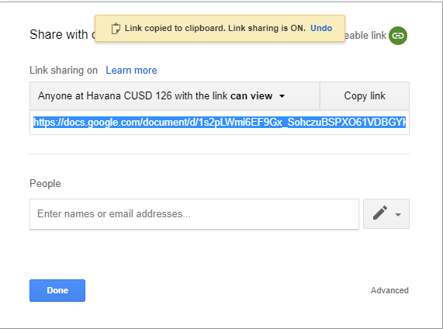
6. The link has been copied for you! You don’t need to do anything else!

Slide 8
7. Go to your Edmodo account.

Slide 9
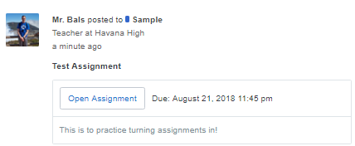
8. Find the assignment titled “Test Assignment” and click “Open Assignment”

Slide 10
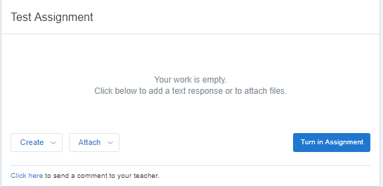
9. Next, choose “Create”. Do not choose attach.

Slide 11
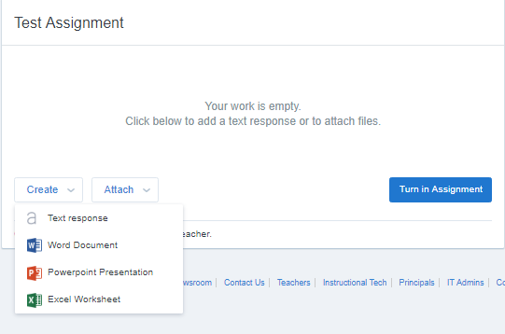
10. After that, choose “Text response”.

Slide 12
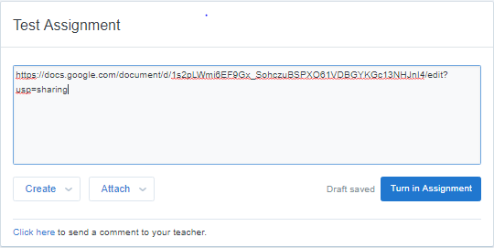
11. Then, paste your shareable link into the box

Slide 13
12. Finally, choose “Turn in assignment”

Slide 14
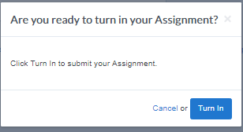
13. And then turn in again!

Slide 15
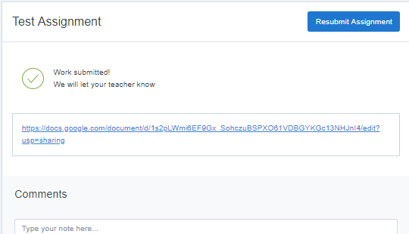
14. Congrats! You did it!

